Slide 1


IMON
International
Sustainability report (ESG)
H1 2026
CJSC Bank "IMON INTERNATIONAL"

Slide 2
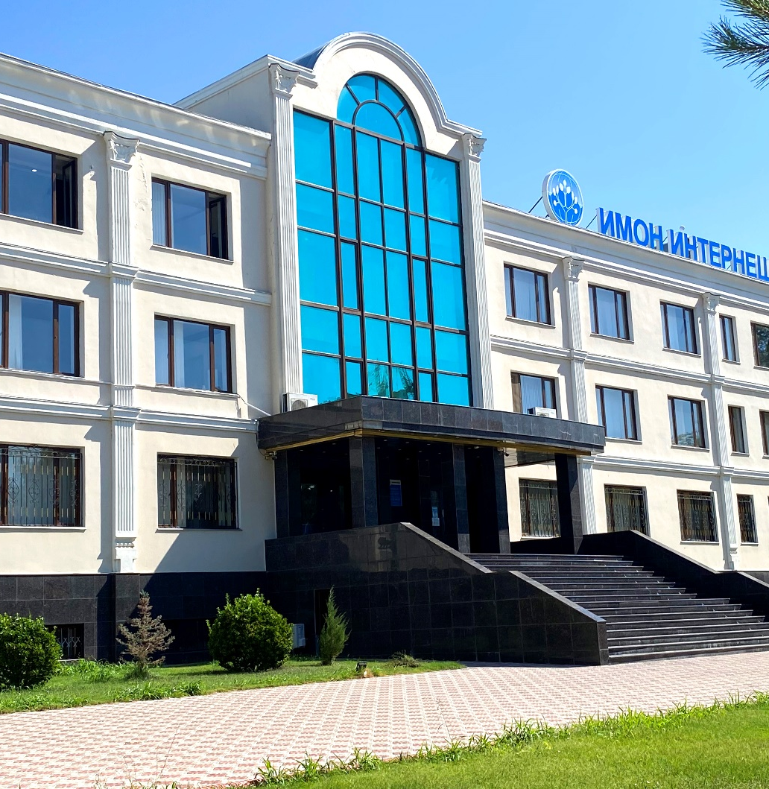
Content of report
Description of report 3
Summary of the Bank and its achievements 4
Environmental and Social initiatives 5
SDG achievements by 2025 6
Sustainable Development of the Bank 8
    The Path to ESG Transformation
    Objectives and Key areas of the Sustainable development
    Sustainability Targets
Social Impact of the Bank 12
    Staff details
    Social benefits and compensation
    Charitable and sponsorship activities
Contact Information 18

Slide 3

Description of report
The 2026 Sustainability Report of Bank IMON International is the official report disclosing key aspects of the Bank's activities in the areas of ESG (environmental sustainability, social responsibility and corporate governance).
The publication of the report underscores the Bank's commitment to the principles of transparency, responsibility and long-term sustainable development.
The content of the report is consistent with the provisions of the following initiatives and documents:
- Principles of the UN Global Compact
- Sustainable Development Goals, approved by the UN General Assembly in 2015
- Nationally Determined Contributions (NDCs) of the Republic of Tajikistan
- Green Economy Development Strategy for the Republic of Tajikistan for 2023–2037
- National Development Strategy of the Republic of Tajikistan for the Period up to 2030
Notes:
In March, write-offs totaling 2.7 mln somoni were approved but not processed in the system. Taking these write-offs into account, the Par30+R is 1.46% (2,013,452 write-offs were made in January, 3,744,671 in February, and 58,878 in March).

Slide 4



Summary of the Bank and its achievements over the past year
27 branches
148,646 active borrowers and savers
85 BSCs
TJS 2,4 bil loan portfolio, +13% compared to 2025
144 ATMs (+45 compared to 2025) &
227 self-service terminals (+29 comp. 2025)
TJS 254 mln saving deposits, +38% compared to 2025
127 POS Terminals (-1 comp. to 2025)
TJS 1,1 bil term deposits, +12% compared to 2025
Notes:
In March, write-offs totaling 2.7 mln somoni were approved but not processed in the system. Taking these write-offs into account, the Par30+R is 1.46% (2,013,452 write-offs were made in January, 3,744,671 in February, and 58,878 in March).

Slide 5
Environmental initiatives
Social initiatives
TJS 65 mln green portfolio, 2.8% of loan portfolio
24% youth borrowers
TJS 748 mln agricultural loans, 32% of loan portfolio
43% active female clients
1,105 loans disbursed online, 1% of disbursed loans
2,074 participants received trainings
9 hours of trainings per employee
Notes:
In March, write-offs totaling 2.7 mln somoni were approved but not processed in the system. Taking these write-offs into account, the Par30+R is 1.46% (2,013,452 write-offs were made in January, 3,744,671 in February, and 58,878 in March).

Slide 6




SDG achievements by H1 2026
SDG
Result for 2026:
127,488 active borrowers served across Tajikistan; 20,967 first-time borrowers financed during H1 2026; 21,158 active savers; TJS 2.4 bln outstanding loan portfolio supporting household and business income generation.
47% - Women among all employees; 33% - Women among heads of units and departments; 14% - Women in senior management; 11% - Women among all Branch directors; 51.1% - of all hired employees are women.
TJS 2.4 bln loan portfolio supporting MSMEs and individual entrepreneurs; 126,222 loans disbursed during H1 2026; 1,444 employees nationwide; 512 loan officers providing financial services across Tajikistan.
TJS 65 mln green loans portfolio, 2.8% of loan portfolio.
Notes:
In March, write-offs totaling 2.7 mln somoni were approved but not processed in the system. Taking these write-offs into account, the Par30+R is 1.46% (2,013,452 write-offs were made in January, 3,744,671 in February, and 58,878 in March).

Slide 7

SDG target achievements
SDG
2027
2028
2029
Expand lending activities in underserved rural areas; Increase the number of first-time borrowers by 10%; Launch financial literacy initiatives in at least 5 regions. | Increase outreach to financially excluded clients by 20% compared to 2026 baseline; Introduce affordable financial products for low-income households and microentrepreneurs; Expand financial literacy programs nationwide. | Establish a strong nationwide financial inclusion program; Significantly increase access to finance for underserved population; Become one of the leading providers of inclusive financial services in Tajikistan.
Reach 48% women among all employees; Reach 34% women among heads of units and departments; Design and pilot a Women's Entrepreneurship loan product. | Reach 49% women among all employees; Maintain at least 35% women among heads of units and departments; Expand Women's Entrepreneurship financing program nationwide. | Achieve 50% women among all employees; Maintain at least 35% women in managerial positions; Establish Women's Entrepreneurship as a permanent business line.
Continue expanding MSME financing and entrepreneurship support; Enhance employee training and professional development programs; Promote safe and inclusive working conditions. | Increase financing for businesses contributing to job creation; Expand digital financial services and remote customer access; Strengthen employee development and productivity initiatives. | Further expand financing to MSMEs and growth-oriented businesses; Position the Bank as a key contributor to entrepreneurship and economic growth in Tajikistan; Maintain a strong organizational culture focused on decent work and continuous professional development.
Increase green loan portfolio to 3.5% of total loan portfolio; Gradual transition of vehicle fleet to electric vehicles; Assess solar energy opportunities for Bank facilities. | Increase green loan portfolio to 4.2% of total loan portfolio; Continue replacing conventional vehicles with electric vehicles; Implement pilot solar energy solutions in selected locations. | Increase green loan portfolio to 5% of total loan portfolio; Complete transition plan for priority vehicle fleet; Generate 25% of electricity consumption from solar energy sources.
Notes:
In March, write-offs totaling 2.7 mln somoni were approved but not processed in the system. Taking these write-offs into account, the Par30+R is 1.46% (2,013,452 write-offs were made in January, 3,744,671 in February, and 58,878 in March).

Slide 8

Sustainable Development of the Bank

Slide 9
The Path to ESG Transformation
Start.
Signing a service agreement with Agents for Impact on ESG implementation
Adoption of regulatory
documents in the field of ESG.
Priority SDGs have been adopted.
Strategic development within the framework of the adopted SDGs
2026
Q3
2027
Q1
Active phase of ESG development
2025
2024
2026
2026
Q2-4
2027-2029
Appointment of ESG coordinators in the Bank.
Involvement of international experts
Obtaining an
Agents for Impact Sustainability Alignment Rating (AFISAR)
Beginning a dialogue with international partners on the issuance of the first
Green Bonds
Notes:
In March, write-offs totaling 2.7 mln somoni were approved but not processed in the system. Taking these write-offs into account, the Par30+R is 1.46% (2,013,452 write-offs were made in January, 3,744,671 in February, and 58,878 in March).

Slide 10
Objectives and Key areas of the Sustainable development
As global decarbonization efforts accelerate, the banking sector's role in providing the necessary financing to support the transition to a green economy is becoming crucial. Bank IMON International has responded to this challenge by making sustainability a strategic priority. We actively support our clients and society on the path to a successful transition to a more sustainable and green economy by offering innovative financial solutions and environmentally focused products. Our commitment to making a significant contribution to sustainable development is driven by our role as one of the leading financial institution in Tajikistan’s development. Guided by international standards and principles of sustainable development, we actively strive to align with the goals of the 2015 Paris Agreement and the UN Sustainable Development Goals, integrating these principles into our strategy and daily operations.
Notes:
In March, write-offs totaling 2.7 mln somoni were approved but not processed in the system. Taking these write-offs into account, the Par30+R is 1.46% (2,013,452 write-offs were made in January, 3,744,671 in February, and 58,878 in March).

Slide 11
Sustainability Targets
Bank IMON International is one of the leading financial institutions in Tajikistan. Over the years, the Bank has become a reliable pillar of development, providing access to modern financial services for both individuals and businesses.
Bank is actively implementing sustainable development principles, including environmental, social, and governance (ESG) factors, integrating them into its operations to achieve long-term sustainable results.
Since 2015, the Bank has actively participated in various green finance programs implemented by international development institutions. The Bank also joined the EBRD Women in Business, CA WIB and GEFF programs underscoring its commitment to supporting equal opportunities for all entrepreneurs.
Notes:
In March, write-offs totaling 2.7 mln somoni were approved but not processed in the system. Taking these write-offs into account, the Par30+R is 1.46% (2,013,452 write-offs were made in January, 3,744,671 in February, and 58,878 in March).

Slide 12
Social Impact of the Bank

Slide 13
Staff details
At the end of June 2026, the Bank had 1,444 employees*, 680 of whom were women and 764 men. The age distribution of employees is as follows: 41% are under 35 and 59% are over 35.
*1,444 total employees considering employees on maternity leave.
Notes:
In March, write-offs totaling 2.7 mln somoni were approved but not processed in the system. Taking these write-offs into account, the Par30+R is 1.46% (2,013,452 write-offs were made in January, 3,744,671 in February, and 58,878 in March).

Slide 14
Staff details
At the end of June 2026, the Bank had 512 loan officers*, 252 of whom were women and 260 men. The number of managers at all levels was 316, 103 of whom were women and 213 men.
*545 loan officers taking into account employees on maternity leave.
Notes:
In March, write-offs totaling 2.7 mln somoni were approved but not processed in the system. Taking these write-offs into account, the Par30+R is 1.46% (2,013,452 write-offs were made in January, 3,744,671 in February, and 58,878 in March).

Slide 15
Social benefits and compensation available to Bank employees
Sports support
The Bank organizes internal football tournaments between employees and branches.
Transfer Compensation
The Bank may reimburse employees for relocation expenses when transferring between Bank branches.
Mobile Communications
The bank reimburses employees for their corporate mobile phone usage.
Notes:
In March, write-offs totaling 2.7 mln somoni were approved but not processed in the system. Taking these write-offs into account, the Par30+R is 1.46% (2,013,452 write-offs were made in January, 3,744,671 in February, and 58,878 in March).

Slide 16
Charitable and sponsorship activities
Charity and social responsibility are important elements of the Bank's activities.
For many years, in addition to its main activities, the Bank has provided assistance and support, within its capabilities, to low-income families and boarding schools.
The Bank also contributes to the cultural development of the population by sponsoring various informational, analytical, cultural, and entertainment television and radio programs, and various public events. This is one of the Bank's key areas of community involvement and covers a range of socially significant areas.
Notes:
In March, write-offs totaling 2.7 mln somoni were approved but not processed in the system. Taking these write-offs into account, the Par30+R is 1.46% (2,013,452 write-offs were made in January, 3,744,671 in February, and 58,878 in March).

Slide 17
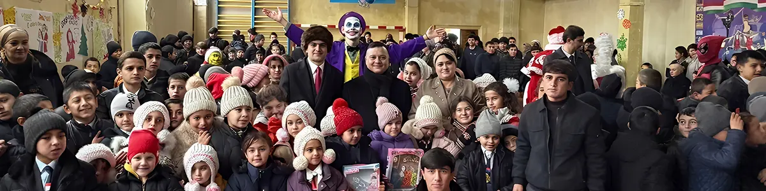
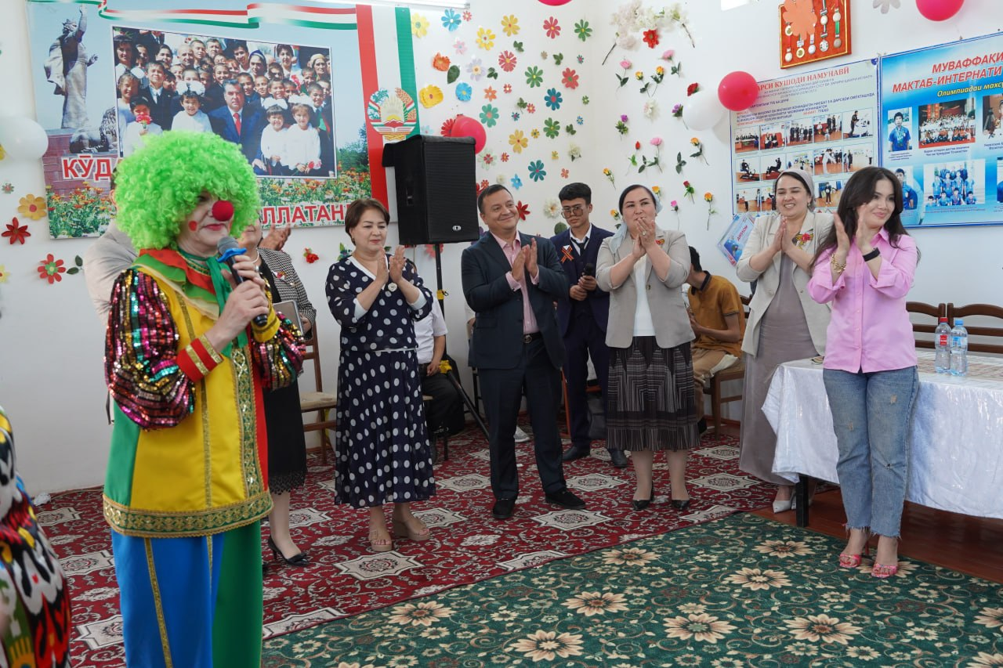

Charitable and sponsorship activities
Notes:
In March, write-offs totaling 2.7 mln somoni were approved but not processed in the system. Taking these write-offs into account, the Par30+R is 1.46% (2,013,452 write-offs were made in January, 3,744,671 in February, and 58,878 in March).

Slide 18


Contact information
Head Office address:
17 microdistrict, building 2, Khujand 735700, Tajikistan
Phone: +992 3422 42353
Sustainability & ESG Contacts
For any questions regarding this report or sustainability initiatives, please contact our team:
ESG Coordinators: Robiyakhon Ashurova, Iso Abdusamiev
Email: rashurova@imon.tj, iso.abdusamiev@imon.tj
Website (link to ESG section): www.imon.tj/en/about/care
18

